Slide 1

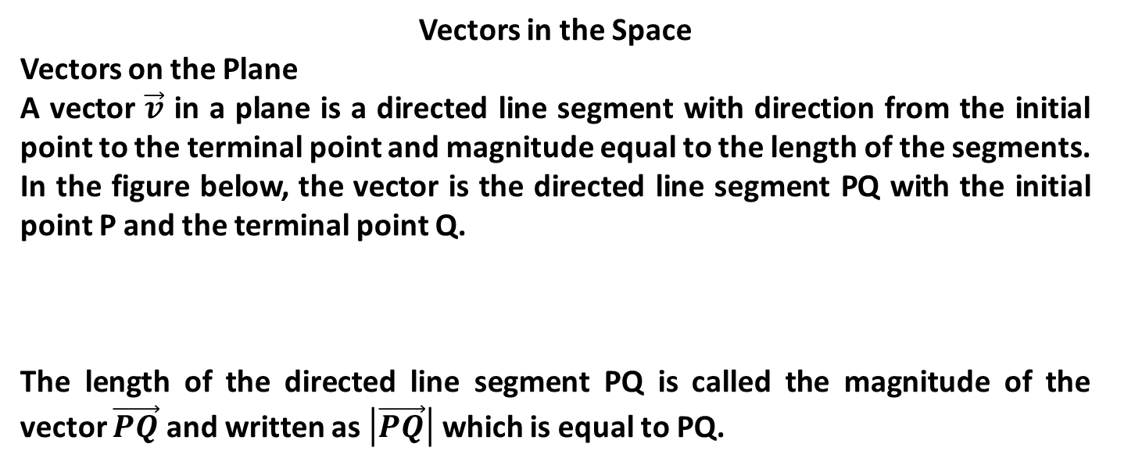

Unit - 9 Vectors and Vector Valued Functions
Vectors in the Space
Vectors on the Plane
A vector $\vec{v}$ in a plane is a directed line segment with direction from the initial point to the terminal point and magnitude equal to the length of the segments.
In the figure below, the vector is the directed line segment PQ with the initial point P and the terminal point Q.
The length of the directed line segment PQ is called the magnitude of the vector $\vec{PQ}$ and written as $\left|\vec{PQ}\right|$ which is equal to PQ.
Q
$$\vec{v}$$
$$\vec{v}=\vec{PQ}$$
P

Slide 2
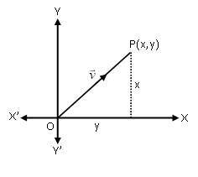

Vectors in Terms of Components (Co-ordinates)
Let $\vec{v}$ be a vector with initial point at origin and the terminal point at a point P with co-ordinates $(x,y)$. Then this vector is written as $\vec{v}=(x,y)$. It is also called the position vector of the point $P(x,y)$.
Note
Let $P(x1,y1)$ and $Q(x2,y2)$ be the initial and the terminal points of the vector . Then it is written as $\vec{PQ}=(x2−x1, y2−y1)$.

Slide 3
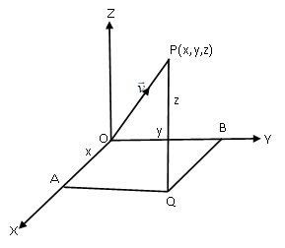

Vectors in Space
Let $\vec{v}$ be a vector with initial point at origin and the terminal point is the point is the point $P$ in the space with co-ordinates $(x,y,z)$. Then vector $\vec{v}$ is written as $\vec{v}=(x,y,z)$.
Note
If it has $P(x1,y1,z1)$ as initial point and $Q(x2,y2,z2)$ as terminal point, then $\vec{PQ}=(x2−x1, y2−y1, z2−z1)$.

Slide 4

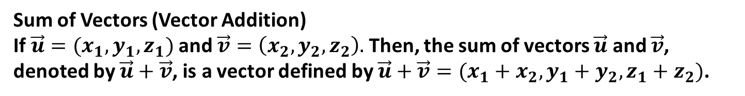
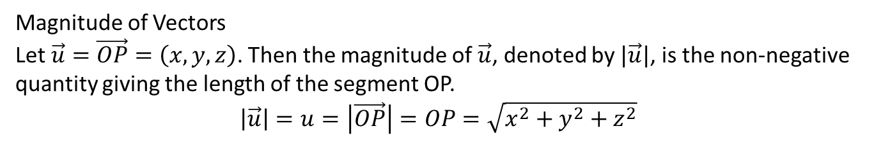
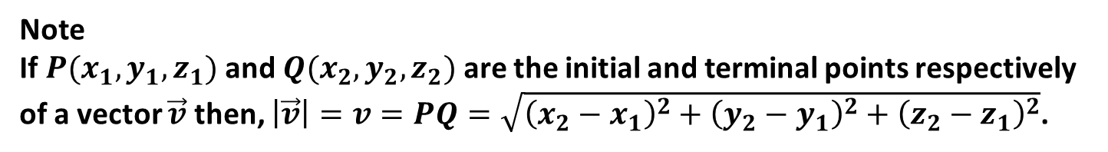
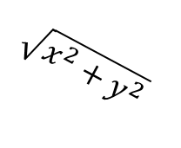
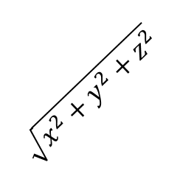
Magnitude of Vectors
Let $\vec{u}=\vec{OP}=\left(x,y,z\right)$. Then the magnitude of $\vec{u}$, denoted by $|\vec{u}|$, is the non-negative
quantity giving the length of the segment OP.
$$\left|\vec{u}\right|=u=\left|\vec{OP}\right|=OP=\sqrt{x^{2}+y^{2}+z^{2}}$$
Z
P$(x,y,z)$
$$\sqrt{x^{2}+y^{2}+z^{2}}$$
O
Y
$$\sqrt{x^{2}+y^{2}}$$
X
Q
Note
If $P(x_{1},y_{1},z_{1})$ and $Q(x_{2},y_{2},z_{2})$ are the initial and terminal points respectively
of a vector $\vec{v}$ then, $\left|\vec{v}\right|=v=PQ=\sqrt{{\left(x_{2}−x_{1}\right)}^{2}+{\left(y_{2}−y_{1}\right)}^{2}+{\left(z_{2}−z_{1}\right)}^{2}}$.
Sum of Vectors (Vector Addition)
If $\vec{u}=(x_{1},y_{1},z_{1})$ and $\vec{v}=\left(x_{2},y_{2},z_{2}\right).$ Then, the sum of vectors $\vec{u}$ and $\vec{v}$, denoted by $\vec{u}+\vec{v}$, is a vector defined by $\vec{u}+\vec{v}=(x_{1}+x_{2},y_{1}+y_{2},z_{1}+z_{2})$.

Slide 5
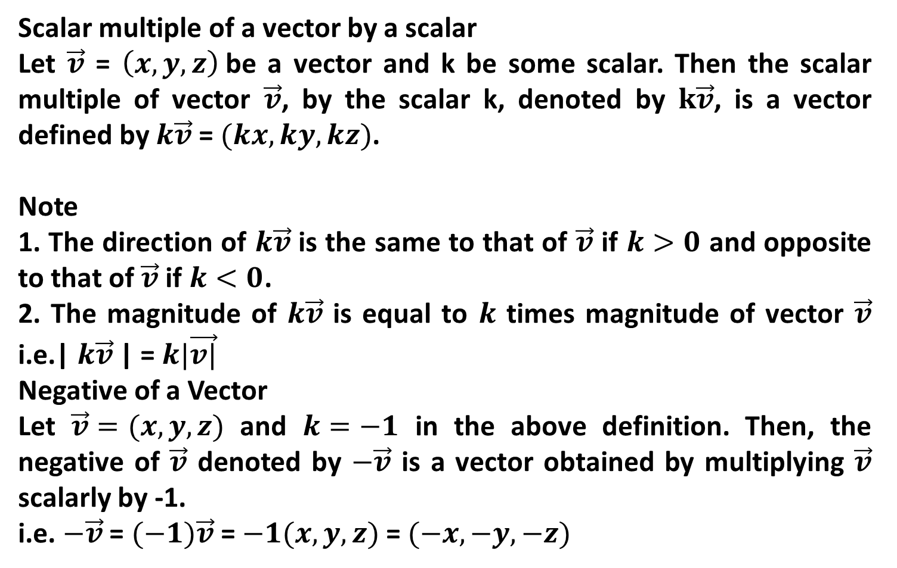
Scalar multiple of a vector by a scalar
Let $\vec{v}$ = $\left(x,y,z\right)$be a vector and k be some scalar. Then the scalar multiple of vector $\vec{v}$, by the scalar k, denoted by $k\vec{v}$, is a vector defined by $k\vec{v}$ = $(kx,ky,kz)$.
Note
1. The direction of $k\vec{v}$ is the same to that of $\vec{v}$ if $k>0$ and opposite to that of $\vec{v}$ if $k<0$.
2. The magnitude of $k\vec{v}$ is equal to $k$ times magnitude of vector $\vec{v}$ i.e.| $k\vec{v}$| = $k|\vec{v|}$
Negative of a Vector
Let $\vec{v}=(x,y,z)$ and $k=−1$ in the above definition. Then, the negative of $\vec{v}$ denoted by $−\vec{v}$ is a vector obtained by multiplying $\vec{v}$ scalarly by -1.
i.e. $−\vec{v}$ = $(−1)\vec{v}$= $−1(x,y,z)$ = $(−x,−y,−z)$

Slide 6
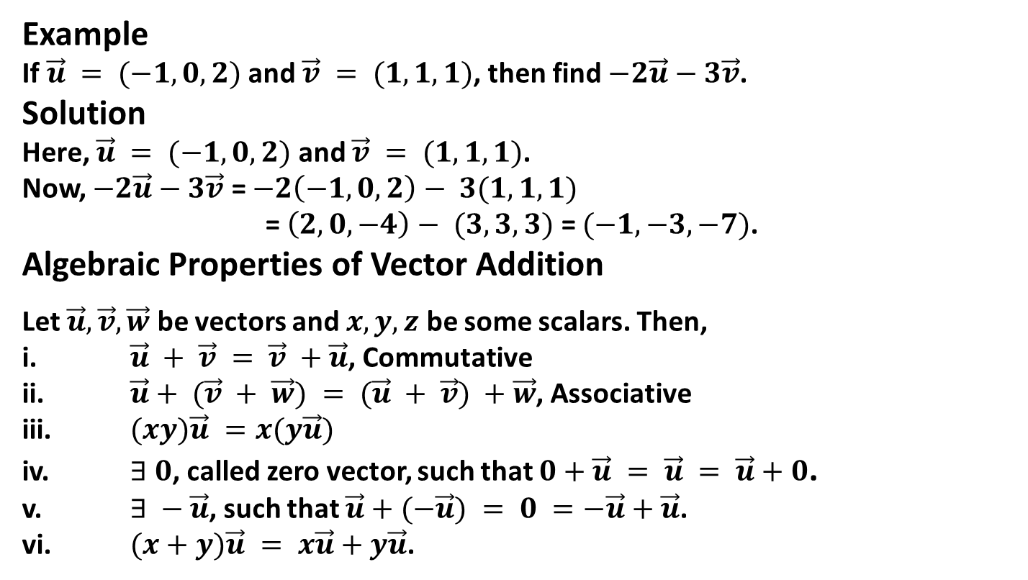
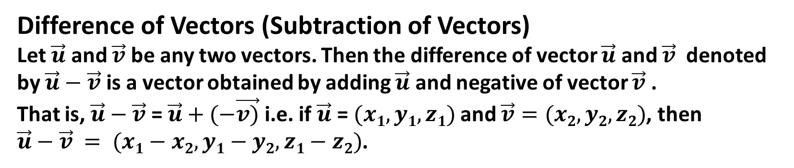
Difference of Vectors (Subtraction of Vectors)
Let $\vec{u}$ and $\vec{v}$ be any two vectors. Then the difference of vector $\vec{u}$ and $\vec{v}$ denoted by $\vec{u}−\vec{v}$ is a vector obtained by adding $\vec{u}$ and negative of vector $\vec{v}$ .
That is, $\vec{u}−\vec{v}$= $\vec{u}+(−\vec{v)}$ i.e. if $\vec{u}$ = $(x1,y1,z1)$and $\vec{v}=(x2,y2,z2)$, then $\vec{u}−\vec{v} = (x1−x2,y1−y2,z1−z2)$.
Example
If $\vec{u} = (−1, 0, 2)$ and $\vec{v} = (1, 1, 1)$, then find $−2\vec{u}−3\vec{v}$.
Solution
Here, $\vec{u} = (−1, 0, 2)$ and $\vec{v} = (1, 1, 1)$.
Now, $−2\vec{u}−3\vec{v}$ = $−2\left(−1,0,2\right)− 3(1,1,1)$
= $\left(2,0,−4\right)− (3,3,3)$ = $(−1,−3,−7)$.
Algebraic Properties of Vector Addition
Let $\vec{u}, \vec{v}, \vec{w}$ be vectors and $x, y, z$ be some scalars. Then,
i. $\vec{u} + \vec{v} = \vec{v} +\vec{u}$, Commutative
ii. $\vec{u}+ (\vec{v} + \vec{w}) = (\vec{u} + \vec{v}) +\vec{w}$, Associative
iii. $(xy)\vec{u} =x(y\vec{u})$
iv. $∃ 0$, called zero vector, such that $0+\vec{u} = \vec{u} = \vec{u}+0$.
v. $∃ −\vec{u}$, such that $\vec{u}+(−\vec{u}) = 0 =−\vec{u}+\vec{u}$.
vi. $(x+y)\vec{u} = x\vec{u}+y\vec{u}$.

Slide 7

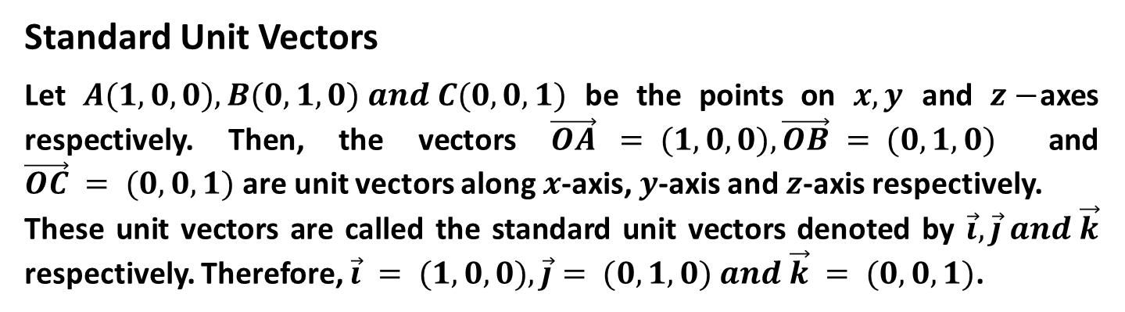
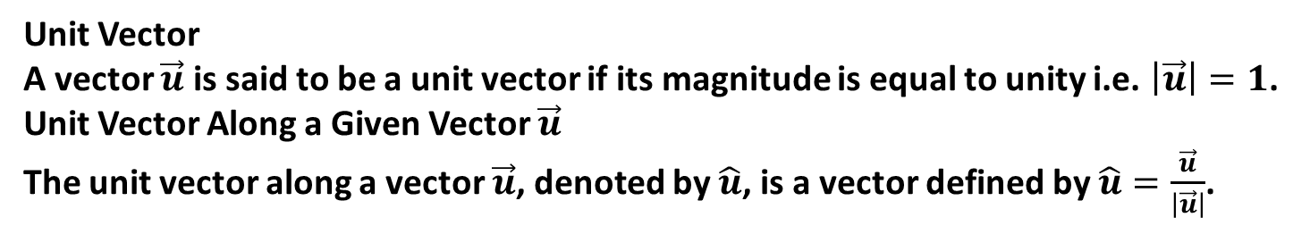
Unit Vector
A vector $\vec{u}$ is said to be a unit vector if its magnitude is equal to unity i.e. $\left|\vec{u}\right|=1$.
Unit Vector Along a Given Vector $\vec{u}$
The unit vector along a vector $\vec{u}$, denoted by $\hat{u}$, is a vector defined by $\hat{u}=\frac{\vec{u}}{\left|\vec{u}\right|}$.
Note: Obviously, $\left|\hat{u}\right|= \left|\frac{\vec{u}}{\left|\vec{u}\right|}\right|=\frac{\left|\vec{u}\right|}{\left|\vec{u}\right|}=1$
Standard Unit Vectors
Let $A(1,0,0), B(0,1,0) and C(0,0,1)$ be the points on $x, y$ and $z−$axes respectively. Then, the vectors $\vec{OA} = (1,0,0), \vec{OB} = (0,1,0)$ and $\vec{OC} = (0,0,1)$ are unit vectors along $x$-axis, $y$-axis and $z$-axis respectively.
These unit vectors are called the standard unit vectors denoted by $\vec{i}, \vec{j} and \vec{k}$ respectively. Therefore, $\vec{i} = (1,0,0), \vec{j}= (0,1,0) and \vec{k} = (0,0,1)$.

Slide 8
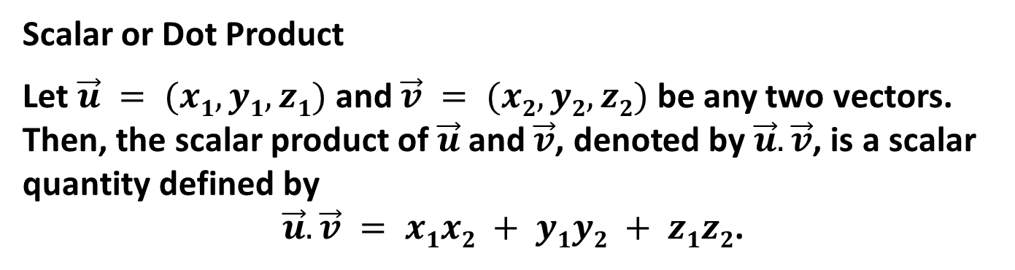
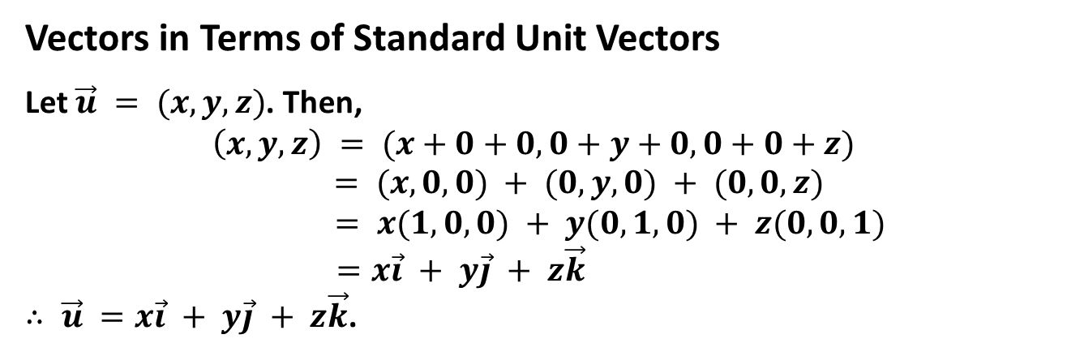
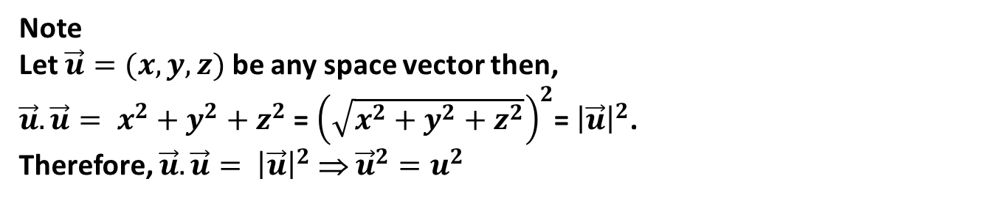
Vectors in Terms of Standard Unit Vectors
Let $\vec{u} = (x,y,z)$. Then,
$$\left(x, y, z\right) = (x+0+0, 0+y+0, 0+0+z) = (x,0,0) + (0,y,0) + (0,0,z)$$
$= x(1,0,0) + y(0,1,0) + z(0,0,1)$
$=x\vec{i} + y\vec{j} + z\vec{k}$
$∴ \vec{u} =x\vec{i} + y\vec{j} + z\vec{k}$.
Scalar or Dot Product
Let $\vec{u} = (x1,y1,z1)$ and $\vec{v} = (x2,y2,z2)$ be any two vectors. Then, the scalar product of $\vec{u}$ and $\vec{v}$, denoted by $\vec{u}.\vec{v}$, is a scalar quantity defined by
$\vec{u}.\vec{v} = x1x2 + y1y2 + z1z2$.
Note
Let $\vec{u}=(x,y,z)$ be any space vector then,
$\vec{u}.\vec{u}= x^{2}+y^{2}+z^{2}$ = ${\left(\sqrt{x^{2}+y^{2}+z^{2}}\right)}^{2}$= ${\left|\vec{u}\right|}^{2}$.
Therefore, $\vec{u}.\vec{u}= {\left|\vec{u}\right|}^{2}$ ⇒ ${\vec{u}}^{2}=u^{2}$

Slide 9

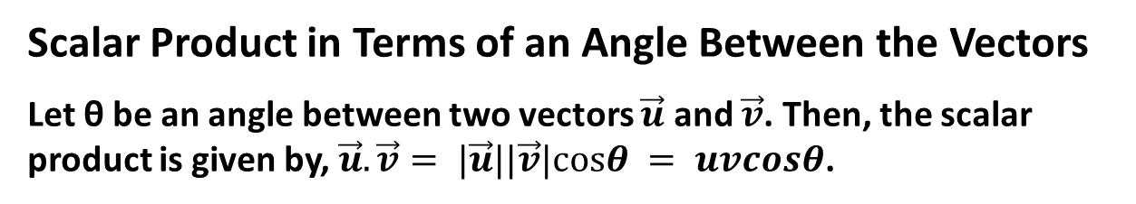
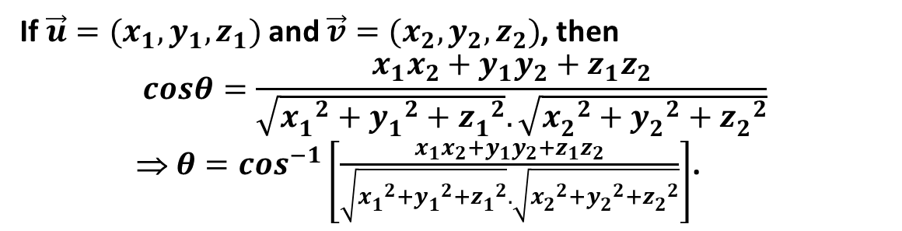
Scalar Product in Terms of an Angle Between the Vectors
Let θ be an angle between two vectors $\vec{u}$ and $\vec{v}$. Then, the scalar product is given by, $\vec{u}.\vec{v}= |\vec{u}||\vec{v}|cosθ = uvcosθ$.
Also, $\vec{u}.\vec{v}=uvcosθ$ ⇒ $cosθ= \frac{\vec{u}.\vec{v}}{uv}$ ⇒ $θ=\cos^{−1}\left(\frac{\vec{u}.\vec{v}}{uv}\right)$.
If $\vec{u}=(x_{1},y_{1},z_{1})$ and $\vec{v}=(x_{2},y_{2},z_{2})$, then
$$cosθ=\frac{x_{1}x_{2}+y_{1}y_{2}+z_{1}z_{2}}{\sqrt{{x_{1}^{}}^{2}+{y_{1}^{}}^{2}+{z_{1}^{}}^{2}}.\sqrt{{x_{2}^{}}^{2}+{y_{2}^{}}^{2}+{z_{2}^{}}^{2}}}$$
⇒ ${θ=cos}^{−1}\left[\frac{x_{1}x_{2}+y_{1}y_{2}+z_{1}z_{2}}{\sqrt{{x_{1}^{}}^{2}+{y_{1}^{}}^{2}+{z_{1}^{}}^{2}}.\sqrt{{x_{2}^{}}^{2}+{y_{2}^{}}^{2}+{z_{2}^{}}^{2}}}\right]$.

Slide 10
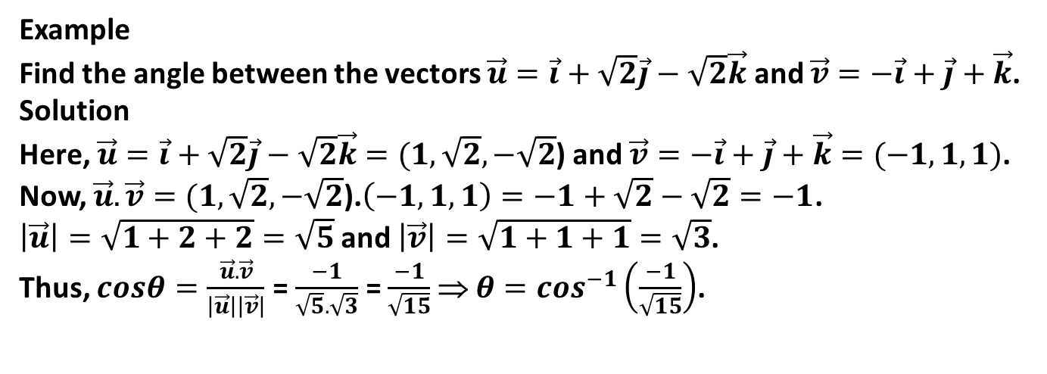
Example
Find the angle between the vectors $\vec{u}=\vec{i}+\sqrt{2}\vec{j}−\sqrt{2}\vec{k}$ and $\vec{v}=−\vec{i}+\vec{j}+\vec{k}$.
Solution
Here, $\vec{u}=\vec{i}+\sqrt{2}\vec{j}−\sqrt{2}\vec{k}=(1,\sqrt{2},−\sqrt{2}$) and $\vec{v}=−\vec{i}+\vec{j}+\vec{k}=(−1,1,1)$.
Now, $\vec{u}.\vec{v}=(1,\sqrt{2},−\sqrt{2}\text{)}\text{.}\left(−1,1,1\right)=−1+\sqrt{2}−\sqrt{2}=−1$.
$\left|\vec{u}\right|=\sqrt{1+2+2}=\sqrt{5}$and $\left|\vec{v}\right|=\sqrt{1+1+1}=\sqrt{3}$.
Thus, $cosθ=\frac{\vec{u}.\vec{v}}{\left|\vec{u}\right|\left|\vec{v}\right|}$ = $\frac{−1}{\sqrt{5}.\sqrt{3}}$ = $\frac{−1}{\sqrt{15}}$ ⇒ $θ=\cos^{−1}\left(\frac{−1}{\sqrt{15}}\right)$.

Slide 11
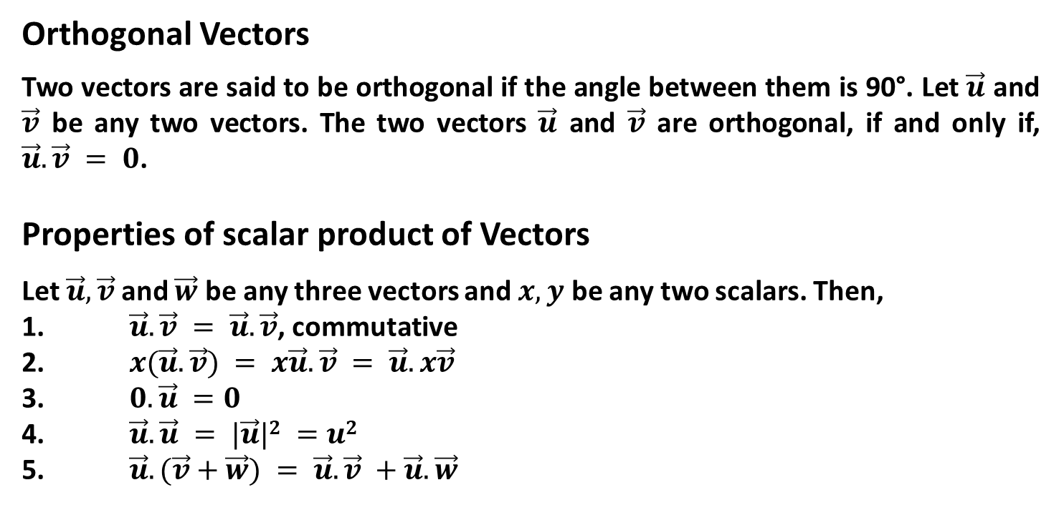
Orthogonal Vectors
Two vectors are said to be orthogonal if the angle between them is 90°. Let $\vec{u}$ and $\vec{v}$ be any two vectors. The two vectors $\vec{u}$ and $\vec{v}$ are orthogonal, if and only if, $\vec{u}.\vec{v} = 0$.
Properties of scalar product of Vectors
Let $\vec{u}, \vec{v}$ and $\vec{w}$ be any three vectors and $x,y$ be any two scalars. Then,
1. $\vec{u}.\vec{v} = \vec{u}.\vec{v}$, commutative
2. $x(\vec{u}.\vec{v}) = x\vec{u}.\vec{v} = \vec{u}.x\vec{v}$
3. $0.\vec{u} =0$
4. $\vec{u}.\vec{u} = |\vec{u}|2 =u2$
5. $\vec{u}.(\vec{v}+\vec{w}) = \vec{u}.\vec{v} +\vec{u}.\vec{w}$

Slide 12
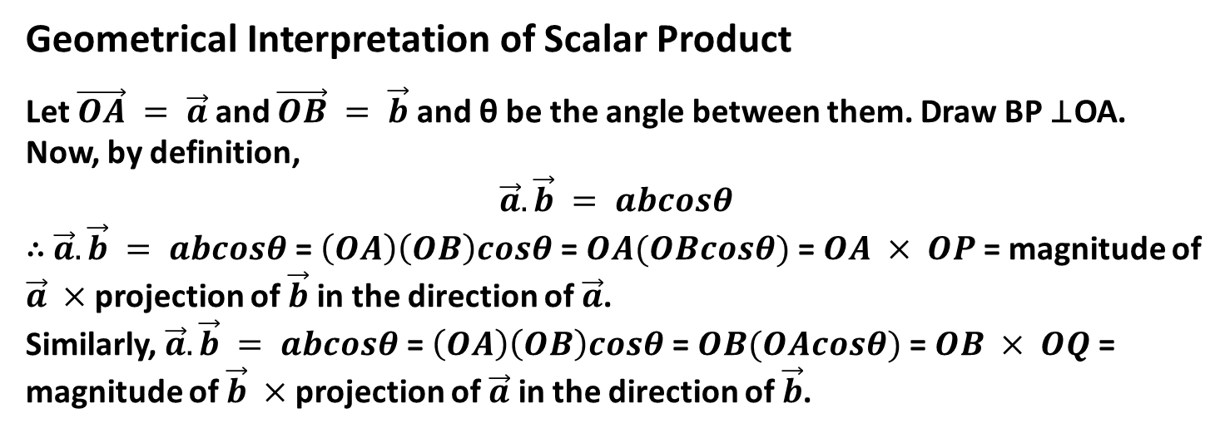
Geometrical Interpretation of Scalar Product
Let $\vec{OA} = \vec{a}$ and $\vec{OB} = \vec{b}$and θ be the angle between them. Draw BP ⊥OA. Now, by definition,
$$\vec{a}.\vec{b} = abcosθ$$
∴ $\vec{a}.\vec{b} = abcosθ$= $\left(OA\right)\left(OB\right)cosθ$= $OA(OBcosθ)$ = $OA × OP$= magnitude of $\vec{a} ×$ projection of $\vec{b}$ in the direction of $\vec{a}$.
Similarly, $\vec{a}.\vec{b} = abcosθ$= $\left(OA\right)\left(OB\right)cosθ$= $OB(OAcosθ)$ = $OB × OQ$= magnitude of $\vec{b} ×$ projection of $\vec{a}$ in the direction of $\vec{b}$.
B
Q
θ
O
A
P

Slide 13
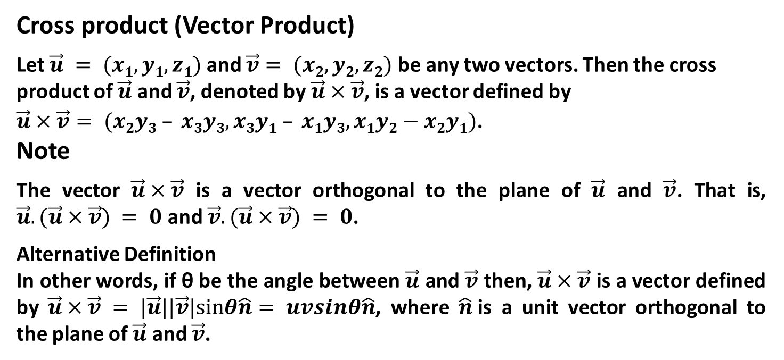
Cross product (Vector Product)
Let $\vec{u} = (x1,y1,z1)$ and $\vec{v}= (x2,y2,z2)$ be any two vectors. Then the cross product of $\vec{u}$ and $\vec{v}$, denoted by $\vec{u}×\vec{v}$, is a vector defined by
$\vec{u}×\vec{v}= (x2y3 – x3y3, x3y1 – x1y3,x1y2−x2y1)$.
Note
The vector $\vec{u}×\vec{v}$ is a vector orthogonal to the plane of $\vec{u}$ and $\vec{v}$. That is, $\vec{u}.(\vec{u}×\vec{v}) = 0$and $\vec{v}.(\vec{u}×\vec{v}) = 0$.
Alternative Definition
In other words, if θ be the angle between $\vec{u}$ and $\vec{v}$ then, $\vec{u}×\vec{v}$ is a vector defined by $\vec{u}×\vec{v} = |\vec{u}||\vec{v}|sinθ\hat{n}= uvsinθ\hat{n}$, where $\hat{n}$is a unit vector orthogonal to the plane of $\vec{u}$ and $\vec{v}$.

Slide 14
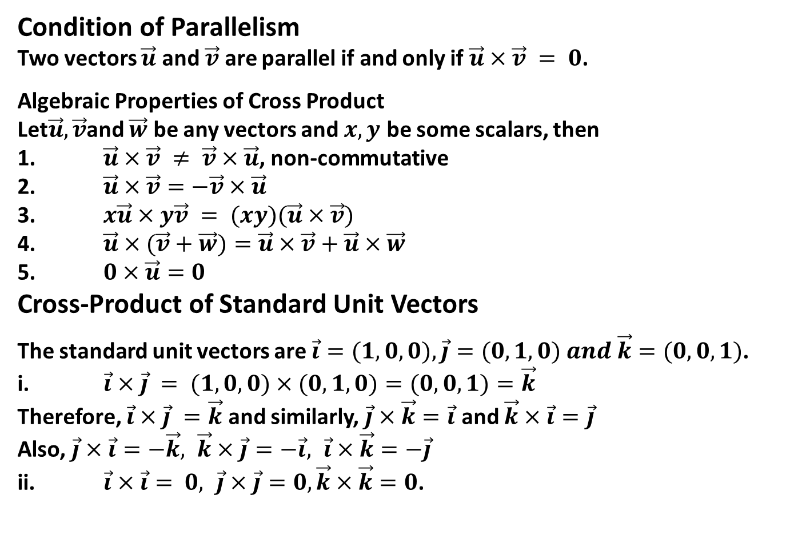
Condition of Parallelism
Two vectors $\vec{u}$ and $\vec{v}$ are parallel if and only if $\vec{u}×\vec{v} = 0$.
Algebraic Properties of Cross Product
Let$\vec{u},\vec{v}$and $\vec{w}$ be any vectors and $x, y$ be some scalars, then
1. $\vec{u}×\vec{v} ≠ \vec{v}×\vec{u}$, non-commutative
2. $\vec{u}×\vec{v}=−\vec{v}×\vec{u}$
3. $x\vec{u}×y\vec{v} = (xy)(\vec{u}×\vec{v})$
4. $\vec{u}×(\vec{v}+\vec{w})=\vec{u}×\vec{v}+\vec{u}×\vec{w}$
5. $0×\vec{u}=0$
Cross-Product of Standard Unit Vectors
The standard unit vectors are $\vec{i}=(1,0,0), \vec{j}=(0,1,0) and \vec{k}=(0,0,1)$.
i. $\vec{i}×\vec{j} = (1,0,0)×(0,1,0)=(0,0,1)=\vec{k}$
Therefore, $\vec{i}×\vec{j} =\vec{k}$ and similarly, $\vec{j}×\vec{k}=\vec{i}$ and $\vec{k}×\vec{i}=\vec{j}$
Also, $\vec{j}×\vec{i}=−\vec{k}, \vec{k}×\vec{j}=−\vec{i}, \vec{i}×\vec{k}=−\vec{j}$
ii. $\vec{i}×\vec{i}= 0, \vec{j}×\vec{j}=0,\vec{k}×\vec{k}=0$.

Slide 15
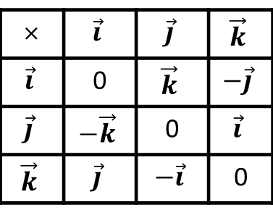
Operation Table for Vector Product
× | $$\vec{i}$$ | $$\vec{j}$$ | $$\vec{k}$$
$$\vec{i}$$ | 0 | $$\vec{k}$$ | $$−\vec{j}$$
$$\vec{j}$$ | $$−\vec{k}$$ | 0 | $$\vec{i}$$
$$\vec{k}$$ | $$\vec{j}$$ | $$−\vec{i}$$ | 0

Slide 16

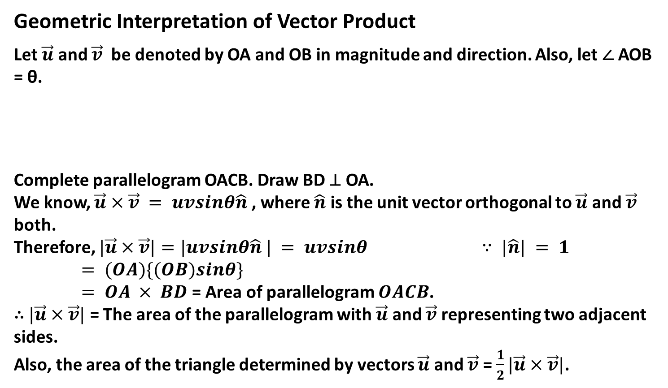

Geometric Interpretation of Vector Product
Let $\vec{u}$ and $\vec{v}$ be denoted by OA and OB in magnitude and direction. Also, let ∠ AOB = θ.
Complete parallelogram OACB. Draw BD ⊥ OA.
We know, $\vec{u}×\vec{v} = uvsinθ\hat{n}$ , where $\hat{n}$ is the unit vector orthogonal to $\vec{u}$ and $\vec{v}$ both.
Therefore, $|\vec{u}×\vec{v}|=|uvsinθ\hat{n} | = uvsinθ$ $∵ |\hat{n}| = 1$
$= (OA)\{(OB)sinθ\}$
$= OA × BD$= Area of parallelogram $OACB$.
∴ $|\vec{u}×\vec{v}|$ = The area of the parallelogram with $\vec{u}$ and $\vec{v}$ representing two adjacent sides.
Also, the area of the triangle determined by vectors $\vec{u}$ and $\vec{v}$ = $\frac{1}{2}|\vec{u}×\vec{v}|$.
B
C
$$\vec{v}$$
θ
O
D
$$\vec{u}$$
A

Slide 17
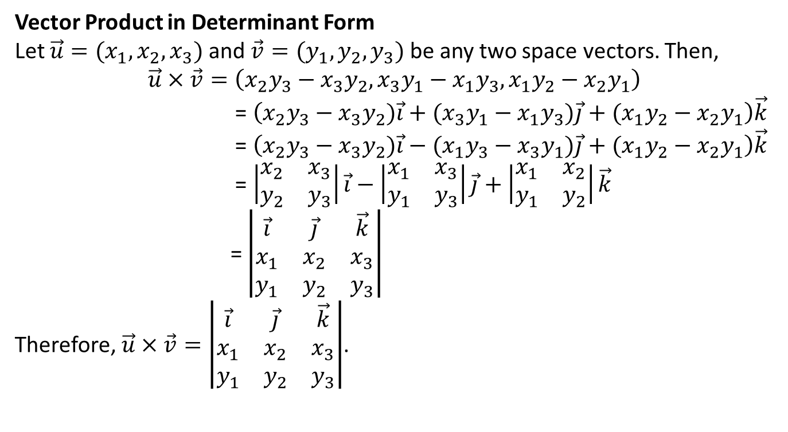
Vector Product in Determinant Form
Let $\vec{u}=(x_{1},x_{2},x_{3})$ and $\vec{v}=(y_{1},y_{2},y_{3})$ be any two space vectors. Then,
$$\vec{u}×\vec{v}=\left(x_{2}y_{3}−x_{3}y_{2},x_{3}y_{1}−x_{1}y_{3},x_{1}y_{2}−x_{2}y_{1}\right)$$
= $\left(x_{2}y_{3}−x_{3}y_{2})\vec{i}+(x_{3}y_{1}−x_{1}y_{3})\vec{j}+(x_{1}y_{2}−x_{2}y_{1}\right)\vec{k}$
= $\left(x_{2}y_{3}−x_{3}y_{2})\vec{i}−(x_{1}y_{3}−x_{3}y_{1})\vec{j}+(x_{1}y_{2}−x_{2}y_{1}\right)\vec{k}$
= $\left|\begin{matrix}x_{2} & x_{3} \\ y_{2} & y_{3}\end{matrix}\right|\vec{i}−\left|\begin{matrix}x_{1} & x_{3} \\ y_{1} & y_{3}\end{matrix}\right|\vec{j}+\left|\begin{matrix}x_{1} & x_{2} \\ y_{1} & y_{2}\end{matrix}\right|\vec{k}$
= $\left|\begin{matrix}\vec{i} & \vec{j} & \vec{k} \\ x_{1} & x_{2} & x_{3} \\ y_{1} & y_{2} & y_{3}\end{matrix}\right|$
Therefore, $\vec{u}×\vec{v}=\left|\begin{matrix}\vec{i} & \vec{j} & \vec{k} \\ x_{1} & x_{2} & x_{3} \\ y_{1} & y_{2} & y_{3}\end{matrix}\right|$.

Slide 18
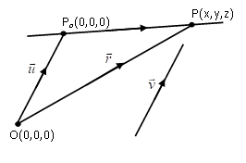
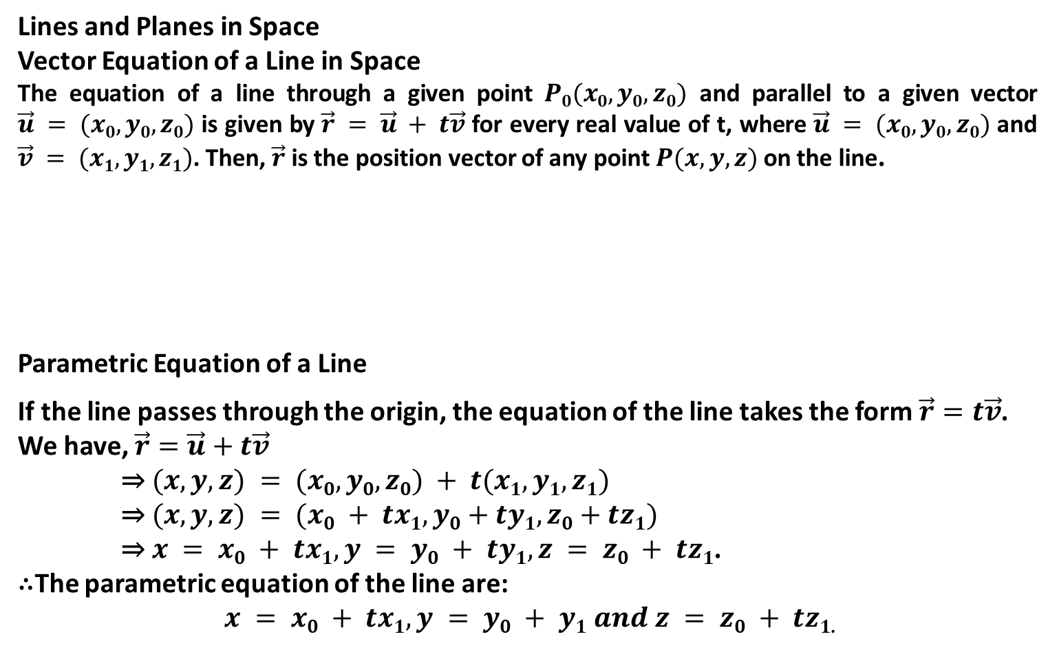
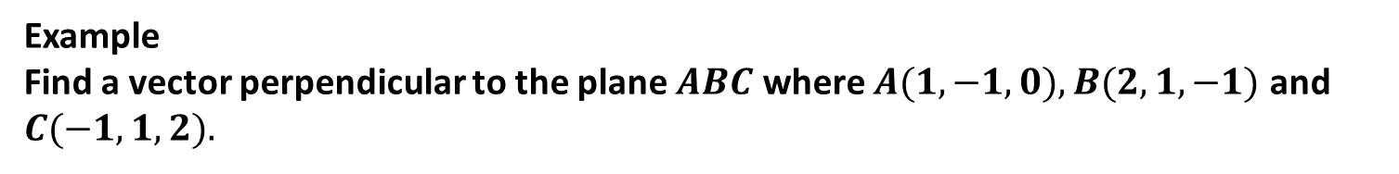
Example
Find a vector perpendicular to the plane $ABC$ where $A(1,−1,0), B(2,1,−1)$ and $C(−1,1,2).$
Lines and Planes in Space
Vector Equation of a Line in Space
The equation of a line through a given point $P0(x0,y0,z0)$ and parallel to a given vector $\vec{u} = (x0,y0,z0)$ is given by $\vec{r} = \vec{u} + t\vec{v}$ for every real value of t, where $\vec{u} = (x0,y0,z0)$ and $\vec{v} = (x1,y1,z1)$. Then, $\vec{r}$ is the position vector of any point $P(x,y,z)$ on the line.
Parametric Equation of a Line
If the line passes through the origin, the equation of the line takes the form $\vec{r}=t\vec{v}$.
We have, $\vec{r}=\vec{u}+t\vec{v}$
⇒ $(x,y,z) = (x0,y0,z0) + t(x1,y1,z1)$
⇒ $(x,y,z) = (x0 + tx1, y0+ty1,z0+tz1)$
⇒ $x = x0 + tx1, y = y0 + ty1, z = z0 + tz1$.
∴The parametric equation of the line are:
$x = x0 + tx1, y = y0 + y1 and z = z0 + tz1$.

Slide 19
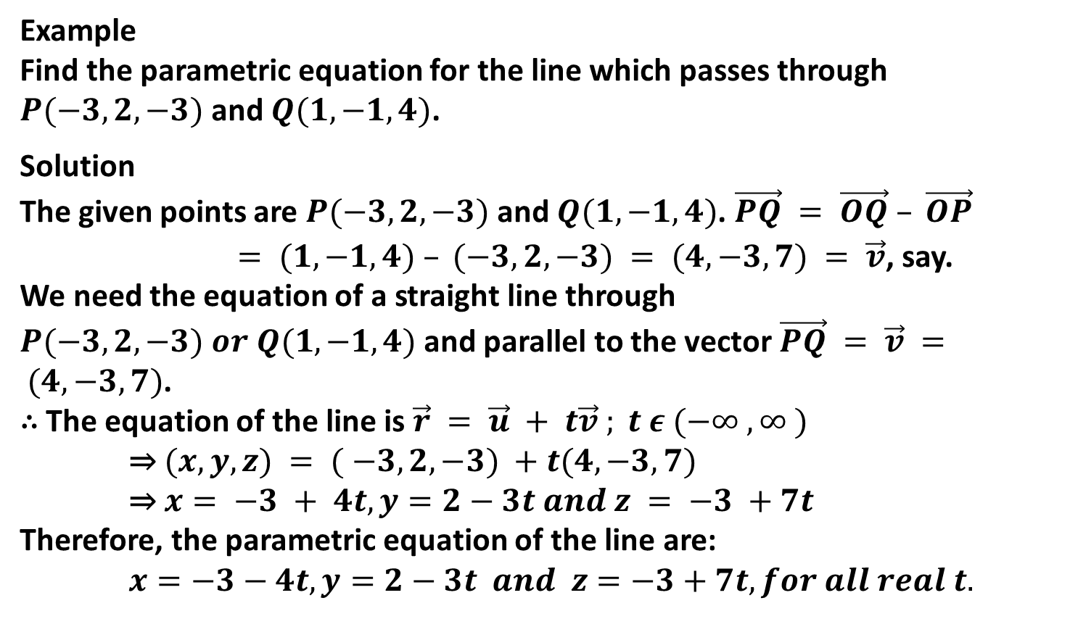
Example
Find the parametric equation for the line which passes through $P(−3,2,−3)$and $Q(1,−1,4)$.
Solution
The given points are $P(−3,2,−3)$ and $Q(1, −1,4)$. $\vec{PQ} = \vec{OQ} – \vec{OP}$
$= (1,−1,4) – (−3,2,−3) = (4, −3, 7) = \vec{v}$, say.
We need the equation of a straight line through $P(−3,2,−3) or Q(1,−1,4)$ and parallel to the vector $\vec{PQ} = \vec{v} = (4, −3, 7)$.
∴ The equation of the line is $\vec{r} = \vec{u} + t\vec{v} ; t ε (−∞ , ∞ )$
⇒ $(x,y,z) = ( −3, 2, −3) +t(4, −3, 7)$
⇒ $x= −3 + 4t, y=2−3t and z = −3 +7t$
Therefore, the parametric equation of the line are:
$x=−3−4t, y=2−3t and z=−3+7t, for all real t.$

Slide 20
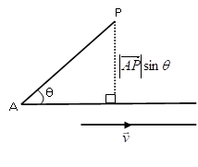
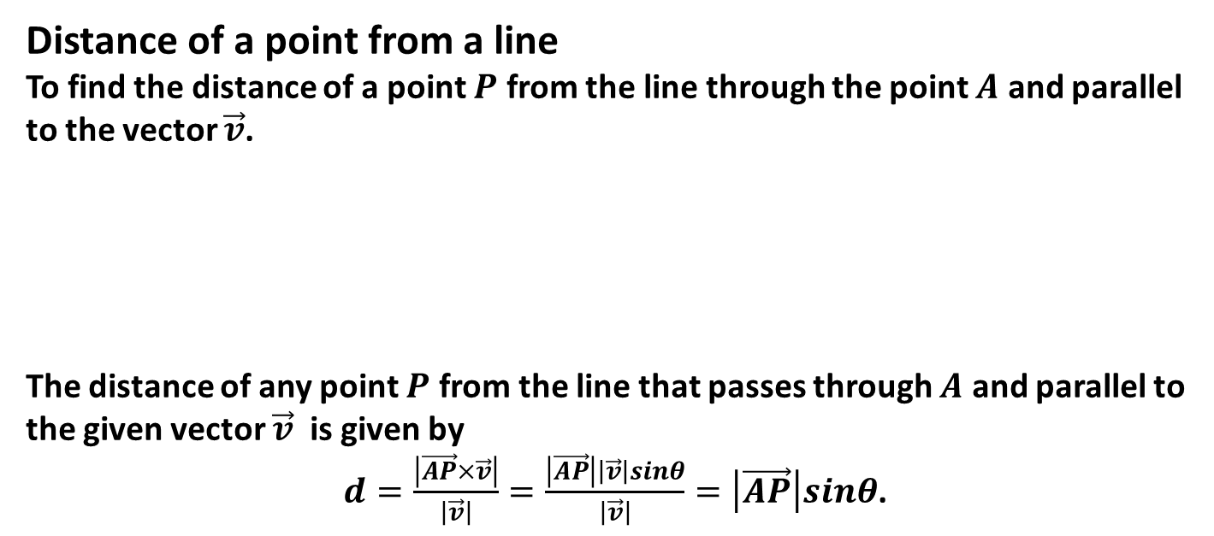
Distance of a point from a line
To find the distance of a point $P$ from the line through the point $A$ and parallel to the vector $\vec{v}$.
The distance of any point $P$ from the line that passes through $A$ and parallel to the given vector $\vec{v}$ is given by
$d=\frac{\left|\vec{AP}×\vec{v}\right|}{\left|\vec{v}\right|}=\frac{\left|\vec{AP}\right|\left|\vec{v}\right|sinθ}{\left|\vec{v}\right|}=\left|\vec{AP}\right|sinθ$.

Slide 21
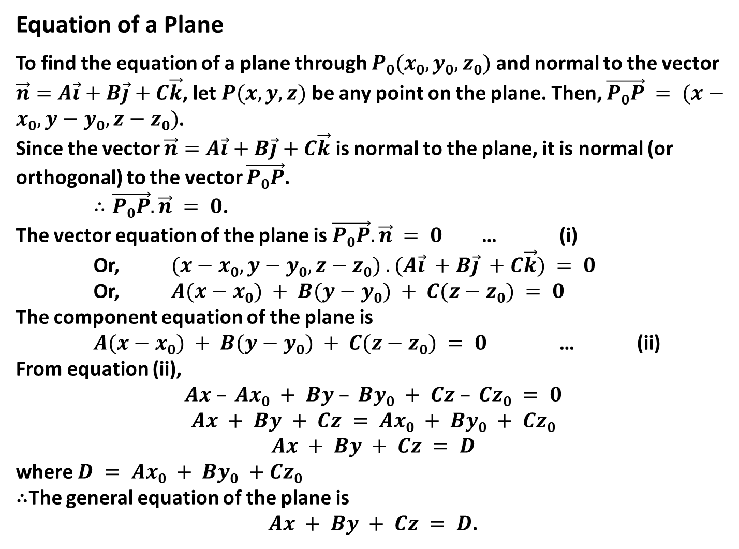
Equation of a Plane
To find the equation of a plane through $P0(x0,y0,z0)$ and normal to the vector $\vec{n}=A\vec{i}+B\vec{j}+C\vec{k}$, let $P(x,y,z)$ be any point on the plane. Then, $\vec{P0P} = (x−x0, y−y0, z−z0)$.
Since the vector $\vec{n}=A\vec{i}+B\vec{j}+C\vec{k}$ is normal to the plane, it is normal (or orthogonal) to the vector $\vec{P0P}$.
$∴\vec{P0P}. \vec{n} = 0$.
The vector equation of the plane is $\vec{P0P}.\vec{n} = 0$ … (i)
Or, $(x−x0, y−y0, z−z0) . (A\vec{i} +B\vec{j} +C\vec{k}) = 0$
Or, $A(x−x0) + B(y−y0) + C(z−z0) = 0$
The component equation of the plane is
$A(x−x0) + B(y−y0) + C(z−z0) = 0$ … (ii)
From equation (ii),
$$Ax – Ax0 + By – By0 + Cz – Cz0 = 0$$
$$Ax + By + Cz = Ax0 + By0 + Cz0$$
$$Ax + By + Cz = D$$
where $D = Ax0 + By0 +Cz0$
∴The general equation of the plane is
$Ax + By + Cz = D$.

Slide 22
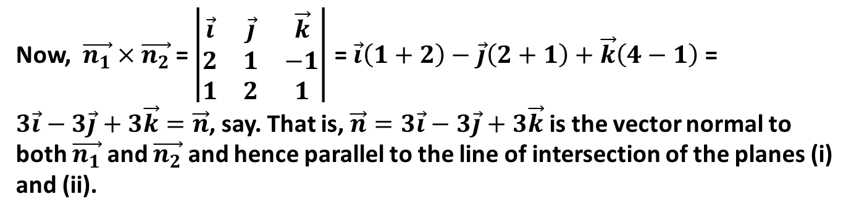
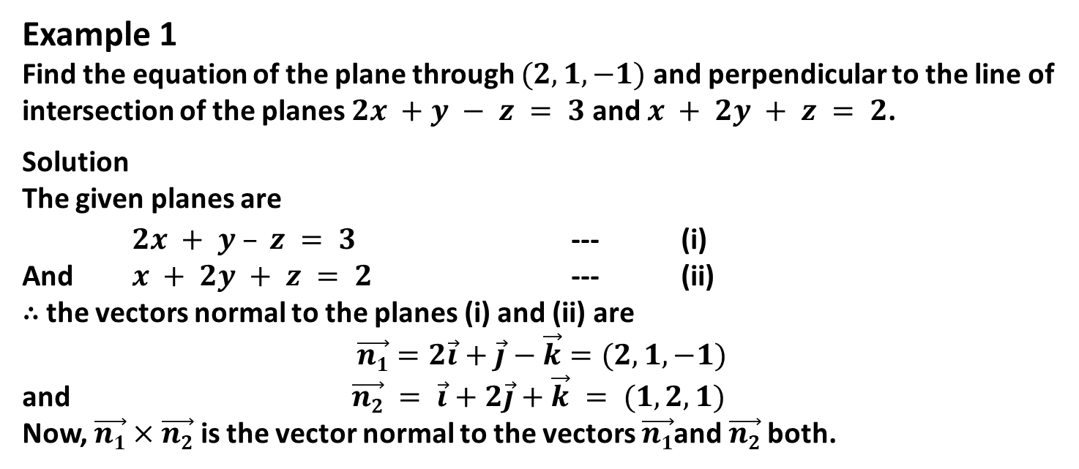
Example 1
Find the equation of the plane through $(2,1,−1)$and perpendicular to the line of intersection of the planes $2x +y − z = 3$and $x + 2y + z = 2$.
Solution
The given planes are
$2x + y – z = 3$ --- (i)
And $x + 2y + z = 2$ --- (ii)
∴ the vectors normal to the planes (i) and (ii) are
$$\vec{n1}=2\vec{i}+\vec{j}−\vec{k}=(2, 1,−1)$$
and $\vec{n2} = \vec{i}+2\vec{j}+\vec{k} = (1, 2, 1)$
Now, $\vec{n1}×\vec{n2}$ is the vector normal to the vectors $\vec{n1}$and $\vec{n2}$both.
Now, $\vec{n_{1}}×\vec{n_{2}}$= $\left|\begin{matrix}\vec{i} & \vec{j} & \vec{k} \\ 2 & 1 & −1 \\ 1 & 2 & 1\end{matrix}\right|$ = $\vec{i}\left(1+2\right)−\vec{j}\left(2+1\right)+\vec{k}\left(4−1\right)$ = $3\vec{i}−3\vec{j}+3\vec{k}=\vec{n}$, say. That is, $\vec{n}=3\vec{i}−3\vec{j}+3\vec{k}$ is the vector normal to both $\vec{n_{1}}$ and $\vec{n_{2}}$ and hence parallel to the line of intersection of the planes (i) and (ii).

Slide 23
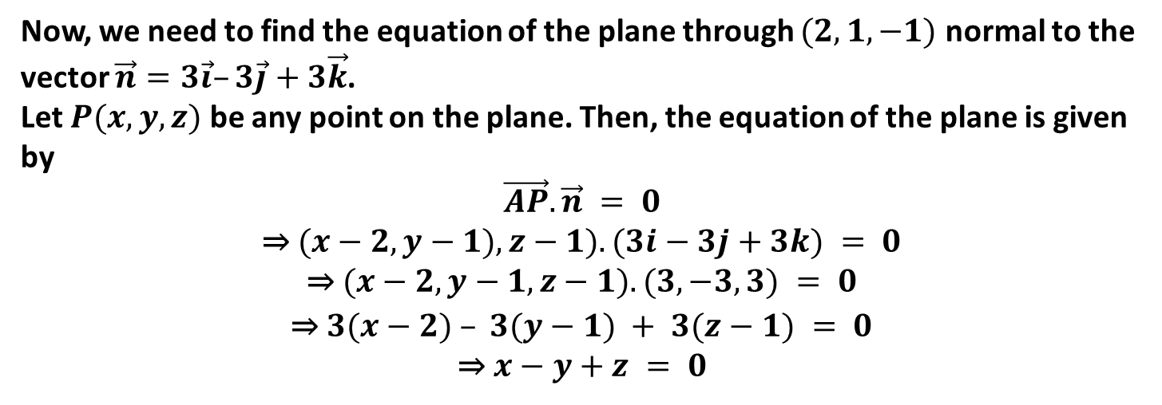
Now, we need to find the equation of the plane through $(2,1,−1)$ normal to the vector $\vec{n}=3\vec{i}–3\vec{j}+3\vec{k}$.
Let $P(x,y,z)$ be any point on the plane. Then, the equation of the plane is given by
$$\vec{AP}.\vec{n} = 0$$
⇒ $(x−2, y−1),z−1). (3i−3j+3k) = 0$
⇒ $(x−2,y−1,z−1).(3,−3,3) = 0$
⇒ $3(x−2) – 3(y−1) + 3(z−1) = 0$
⇒ $x−y+z = 0$

Slide 24
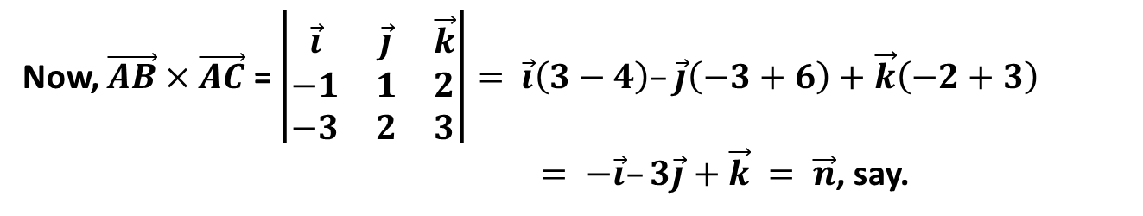
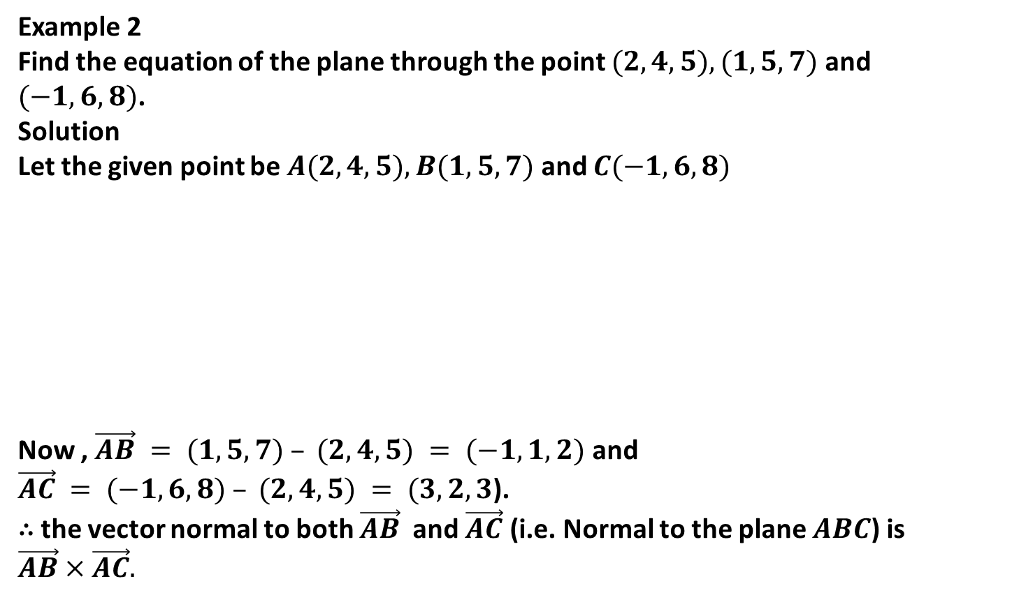
Example 2
Find the equation of the plane through the point $(2,4,5), (1,5,7)$ and $(−1,6,8)$.
Solution
Let the given point be $A(2,4,5), B(1,5,7)$ and $C(−1,6,8)$
Now , $\vec{AB} = (1,5,7) – (2,4,5) = (−1,1,2)$ and
$\vec{AC} = (−1,6,8) – (2,4,5) = (3,2,3$).
∴ the vector normal to both $\vec{AB}$ and $\vec{AC}$ (i.e. Normal to the plane $ABC$) is $\vec{AB}×\vec{AC}.$
A(2,4,5)
B(1,5,7)
C(-1,6,8)
Now, $\vec{AB}×\vec{AC}$ = $\left|\begin{matrix}\vec{i} & \vec{j} & \vec{k} \\ −1 & 1 & 2 \\ −3 & 2 & 3\end{matrix}\right|=$ $\vec{i}\left(3−4\right)–\vec{j}\left(−3+6\right)+\vec{k}\left(−2+3\right)$
$= −\vec{i}–3\vec{j}+\vec{k} = \vec{n}$, say.

Slide 25
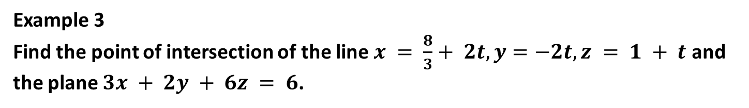
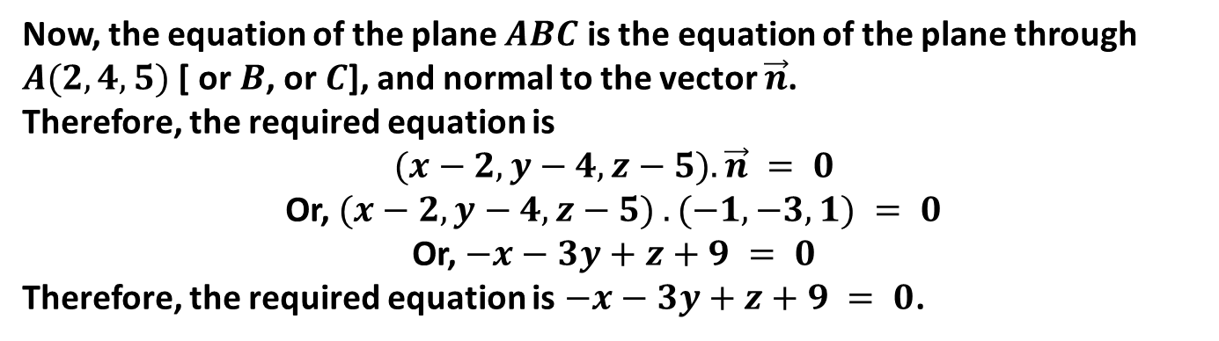
Now, the equation of the plane $ABC$ is the equation of the plane through $A(2,4,5)$ [ or $B$, or $C$], and normal to the vector $\vec{n}$.
Therefore, the required equation is
$$(x−2, y−4, z−5). \vec{n} = 0$$
Or, $(x−2, y−4,z−5) . (−1, −3, 1) = 0$
Or, $−x−3y+z+9 = 0$
Therefore, the required equation is $−x−3y+z+9 = 0$.
Example 3
Find the point of intersection of the line $x = \frac{8}{3}+ 2t, y=−2t, z = 1 + t$ and the plane $3x + 2y + 6z = 6$.

Slide 26
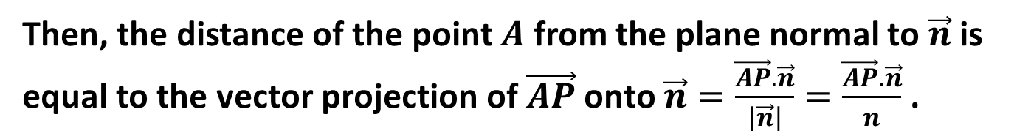
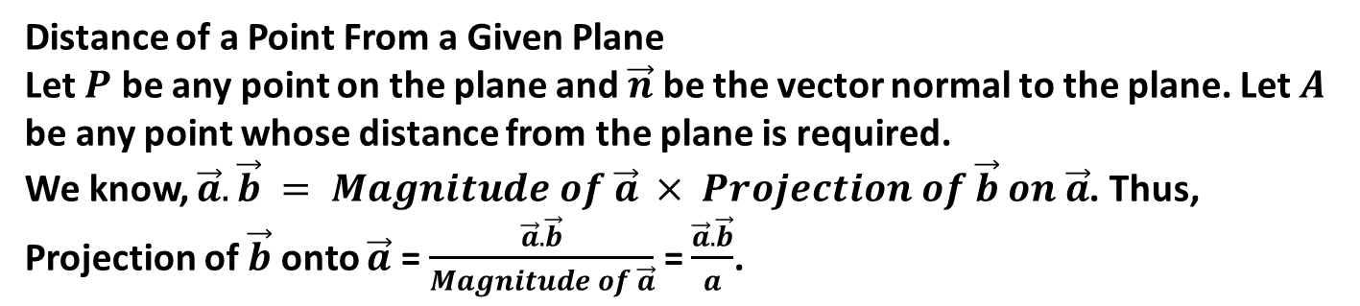
Distance of a Point From a Given Plane
Let $P$ be any point on the plane and $\vec{n}$ be the vector normal to the plane. Let $A$ be any point whose distance from the plane is required.
We know, $\vec{a}.\vec{b} = Magnitude of \vec{a} × Projection of \vec{b} on \vec{a}$. Thus, Projection of $\vec{b}$ onto $\vec{a}$ = $\frac{\vec{a}.\vec{b}}{Magnitude of \vec{a}}$ = $\frac{\vec{a}.\vec{b}}{a}$.
Then, the distance of the point $A$ from the plane normal to $\vec{n}$ is equal to the vector projection of $\vec{AP}$ onto $\vec{n}=\frac{\vec{AP}.\vec{n}}{\left|\vec{n}\right|}=\frac{\vec{AP}.\vec{n}}{n}$ .

Slide 27
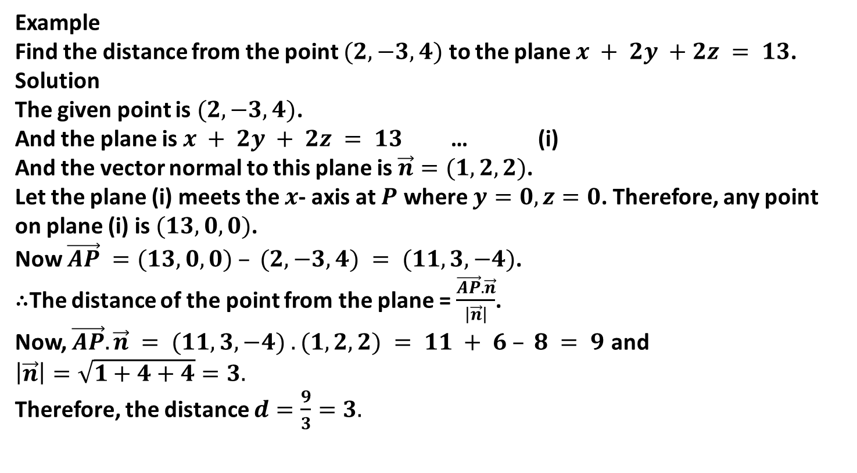
Example
Find the distance from the point $(2,−3,4)$ to the plane $x + 2y +2z = 13$.
Solution
The given point is $(2,−3,4)$.
And the plane is $x + 2y + 2z = 13$ … (i)
And the vector normal to this plane is $\vec{n}=(1,2,2)$.
Let the plane (i) meets the $x$- axis at $P$ where $y=0, z=0$. Therefore, any point on plane (i) is $(13,0,0)$.
Now $\vec{AP} =(13,0,0) – (2,−3,4) = (11,3,−4)$.
∴The distance of the point from the plane = $\frac{\vec{AP}.\vec{n}}{\left|\vec{n}\right|}$.
Now, $\vec{AP}.\vec{n} = (11, 3, −4) . (1,2,2) = 11 + 6 – 8 = 9$ and $\left|\vec{n}\right|=\sqrt{1+4+4}=3.$
Therefore, the distance $d=\frac{9}{3}=3.$

Slide 28
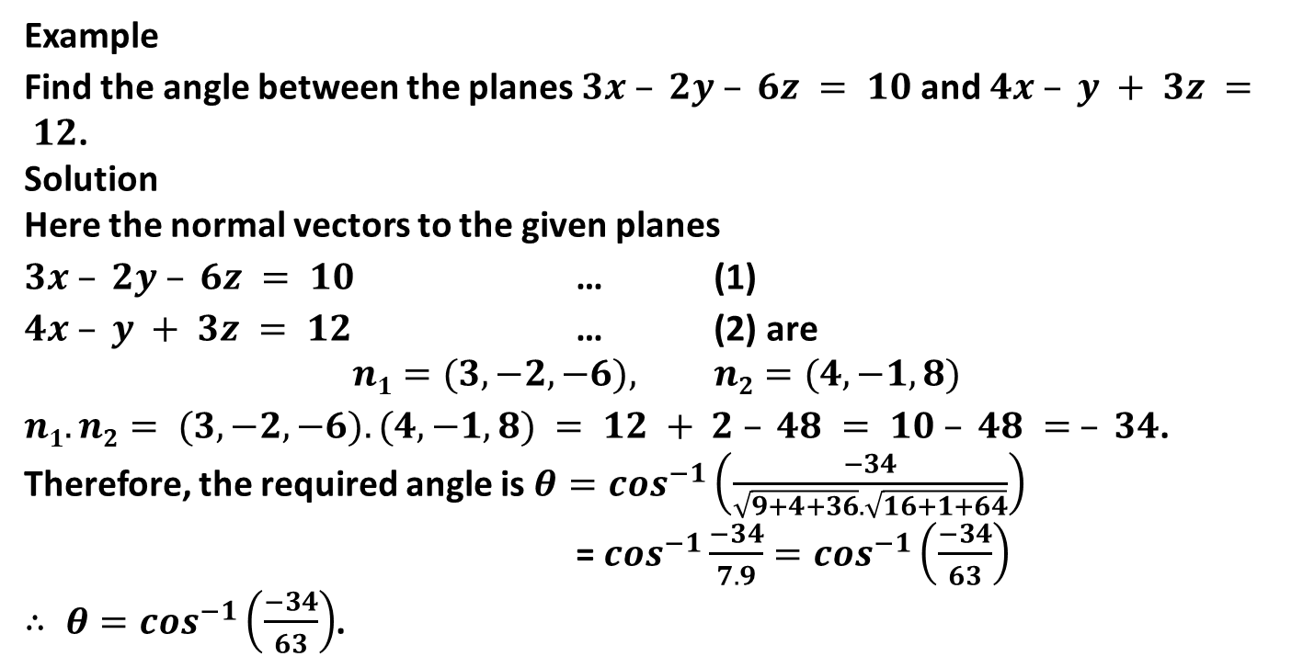
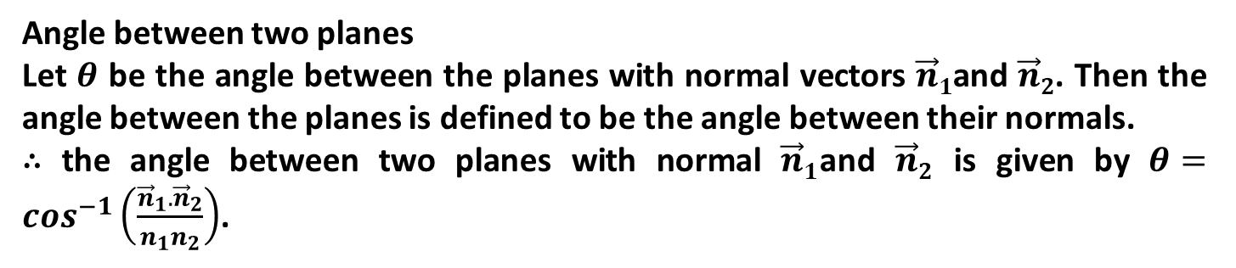
Angle between two planes
Let $θ$ be the angle between the planes with normal vectors $\vec{n}1$and $\vec{n}2$. Then the angle between the planes is defined to be the angle between their normals.
∴ the angle between two planes with normal $\vec{n}1$and $\vec{n}2$ is given by $θ=\cos^{−1}\left(\frac{{\vec{n}}_{1}.{\vec{n}}_{2}}{n_{1}n_{2}}\right)$.
Example
Find the angle between the planes $3x – 2y – 6z = 10$and $4x – y + 3z = 12$.
Solution
Here the normal vectors to the given planes
$3x – 2y – 6z = 10$ … (1)
$4x – y + 3z = 12$ … (2) are
$$n1=(3, −2, −6), n2=(4, −1, 8)$$
$n1.n2= (3,−2,−6).(4,−1,8) = 12 + 2 – 48 = 10 – 48 = – 34$.
Therefore, the required angle is $θ=\cos^{−1}\left(\frac{−34}{\sqrt{9+4+36}.\sqrt{16+1+64}}\right)$
= $\cos^{−1}\frac{−34}{7.9}=\cos^{−1}\left(\frac{−34}{63}\right)$
$∴ θ=\cos^{−1}\left(\frac{−34}{63}\right)$.

Slide 29
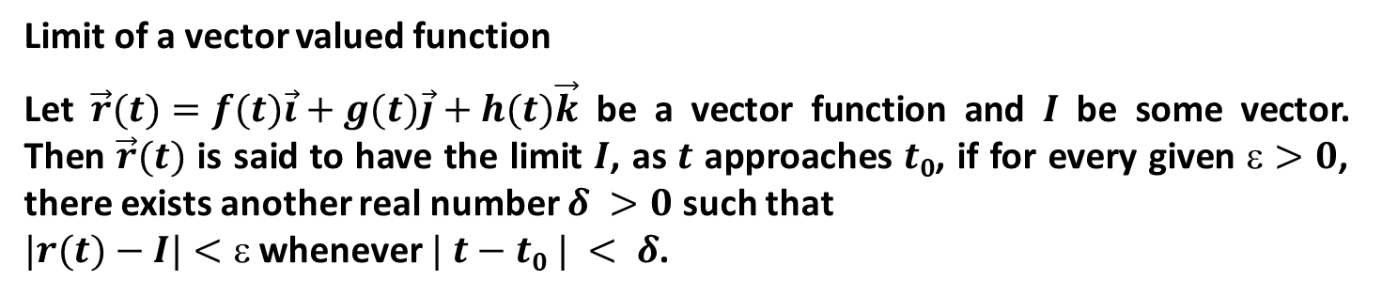
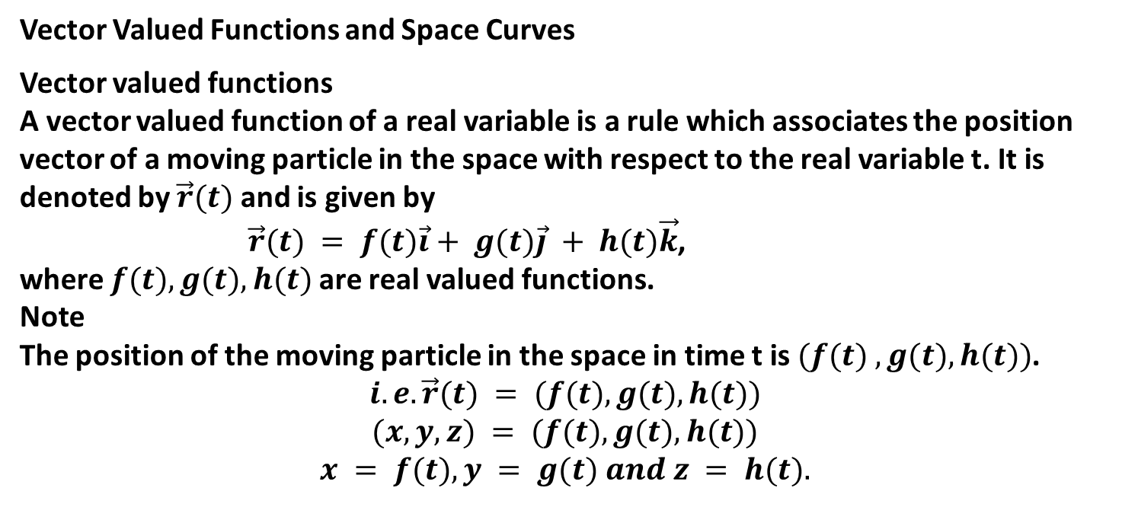
Vector Valued Functions and Space Curves
Vector valued functions
A vector valued function of a real variable is a rule which associates the position vector of a moving particle in the space with respect to the real variable t. It is denoted by $\vec{r}(t)$ and is given by
$\vec{r}(t) = f(t)\vec{i}+ g(t)\vec{j} + h(t)\vec{k}$,
where $f(t), g(t), h(t)$ are real valued functions.
Note
The position of the moving particle in the space in time t is $(f(t) , g(t), h(t))$.
$$i.e. \vec{r}(t) = (f(t), g(t), h(t))$$
$$(x,y,z) = (f(t), g(t), h(t))$$
$$x = f(t), y = g(t) and z = h(t).$$
Limit of a vector valued function
Let $\vec{r}(t)=f(t)\vec{i}+g(t)\vec{j}+h(t)\vec{k}$ be a vector function and $I$ be some vector. Then $\vec{r}(t)$ is said to have the limit $I$, as $t$ approaches $t0$, if for every given $>0$, there exists another real number $δ >0$ such that
$|r(t)−I|<$ whenever $| t−t0 | < δ$.

Slide 30
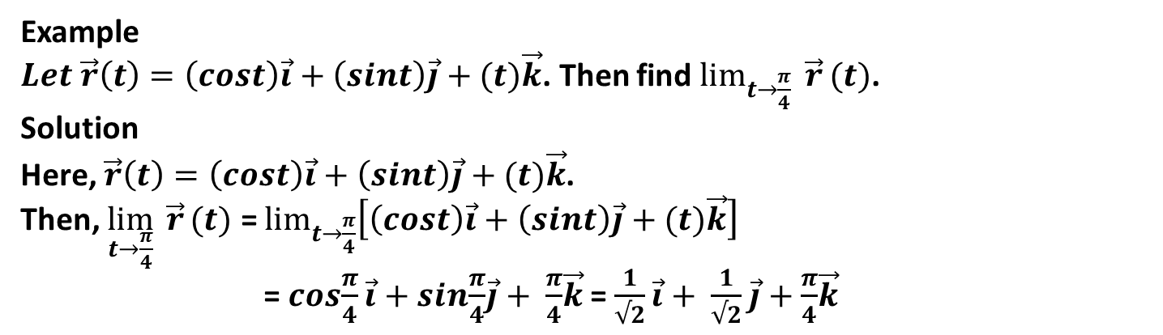

This is written as $\begin{matrix}lim \\ t→t_{0}\end{matrix}r\left(t\right)=l$
Note:
Let $\vec{r}\left(t\right)=f\left(t\right)\vec{i}+g\left(t\right)\vec{j}+h\left(t\right)\vec{k}$ and $\vec{l}=l_{1}\vec{i}+l_{2}\vec{j}+l_{3}\vec{k}$ then, $\lim_{t→t_{0}}{\vec{r}\left(t\right)=\lim_{t→t_{0}}\left[f\left(t\right)\vec{i}+g\left(t\right)\vec{j}+h\left(t\right)\vec{k}\right]}$
= $\lim_{t→t_{0}}\left[f\left(t\right)\right]\vec{i}+\lim_{t→t_{0}}[g\left(t\right)]\vec{j}+\lim_{t→t_{0}}[h\left(t\right)]\vec{k}$
= $l_{1}\vec{i}+l_{2}\vec{j}+l_{3}\vec{k}$
Example
$Let \vec{r}\left(t\right)=\left(cost\right)\vec{i}+\left(sint\right)\vec{j}+(t)\vec{k}$. Then find $\lim_{t→\frac{π}{4}}{\vec{r}}(t)$.
Solution
Here, $\vec{r}\left(t\right)=\left(cost\right)\vec{i}+\left(sint\right)\vec{j}+(t)\vec{k}$.
Then, $\lim_{t→\frac{π}{4}}{\vec{r}}(t)$ = $\lim_{t→\frac{π}{4}}\left[\left(cost\right)\vec{i}+\left(sint\right)\vec{j}+(t)\vec{k}\right]$
= $cos\frac{π}{4}\vec{i}+sin\frac{π}{4}\vec{j}+ \frac{π}{4}\vec{k}$= $\frac{1}{√2}\vec{i}+ \frac{1}{√2}\vec{j}+\frac{π}{4}\vec{k}$

Slide 31


Continuity of a Vector Function
A vector function r(t) is said to be continuous at t = t₀ if $\lim_{t→t_{0}}\left[\vec{r}(t)\right]=\vec{r}(t_{0})$.
Note
A vector function r(t) is said to be continuous in an interval I if it is continuous at every point of it.
Derivative of a vector function
Let $\vec{r}\left(t\right)=f\left(t\right)\vec{i}+g\left(t\right)\vec{j}+h(t)\vec{k}$ be a vector function. It is said to be differentiable with respect to t if f(t), g(t) and h(t) are differentiable with respect to t. The derivative of r(t), denoted by r'(t) is defined as:
$$\vec{r^{′}}\left(t\right)=\frac{d\vec{r}(t)}{dt}=\lim_{∆t→0}\left[\frac{\vec{r}\left(t+∆t\right)−\vec{r}(t)}{∆t}\right]$$
$\frac{df(t)}{dt}\vec{i}+\frac{df(t)}{dt}\vec{j}+\frac{df(t)}{dt}\vec{k}$ = $f^{′}\left(t\right)\vec{i}+g^{′}\left(t\right)\vec{j}+h′(t)\vec{k}$ .

Slide 32


Rules for Differentiation
1. $\frac{d(c)}{dt}=0,$ where c is a constant vector
2. $\frac{d(c\vec{r}(t))}{dt}=$ $c\frac{d(\vec{r}(t))}{dt}$
3. $\frac{d}{dt}\left[\vec{u}\left(t\right)± \vec{v }(t)\right]$ = $\frac{d\vec{u}\left(t\right)}{dt}±\frac{d\vec{v}\left(t\right)}{dt}$
4. $\frac{d}{dt}\left[\vec{u}\left(t\right)× \vec{v }(t)\right]$ = $\vec{u}\left(t\right)\frac{d\vec{v}\left(t\right)}{dt}+\vec{v}(t)\frac{d\vec{u}\left(t\right)}{dt}$
5. $\frac{d}{dt}\left[\frac{\vec{u}(t)}{\vec{v}(t)}\right]$ = $\frac{\vec{v}\left(t\right)\frac{d\vec{u}\left(t\right)}{dt} − \vec{u}(t)\frac{d\vec{v}(t)}{dt}}{{(\vec{v}\left(t\right))}^{2}}$.
Note
Let $\vec{r}(t)$ be a differentiable vector function of a real variable t with constant magnitude. Then, the scalar product of it and its derivative is zero. That is,
$$\vec{r}\left(t\right).\frac{d\vec{r}(t)}{dt}=0$$

Slide 33


Example
Let $\vec{r}\left(t\right)=\left(cost\right)\vec{i}+ √5\vec{j} +\left(sint\right)\vec{k}$, then show that it has a constant length and is orthogonal to its derivative.
Integral of a Vector Function
Let $\vec{R}\left(t\right)$ be a vector function such that $\frac{d\vec{R}(t)}{dt}=\vec{R^{′}}\left(t\right)= \vec{r}(t)$. Then, $\vec{R}(t)$ is said to be an anti-derivative of $\vec{r}(t)$ and is written as $\vec{R}(t)$ = $\int{\vec{r}\left(t\right)dt}$.
Indefinite Integral
Let $\vec{R}\left(t\right)$ be a vector function such that $\vec{R^{′}}\left(t\right)= \vec{r}(t)$. Then, the indefinite integral of $\vec{r}(t)$ is the set of all the integrals of $\vec{r}(t)$ and is given by $\int{\vec{r}\left(t\right)dt}$ = $\vec{R}\left(t\right)$+ c where c is some constant vector.
Note
If $\vec{r}(t)$ =$f\left(t\right)\vec{i}+g\left(t\right)\vec{j}+h(t)\vec{k}$, then $\int{\vec{r}\left(t\right)dt=\int{f\left(t\right)dt\vec{i}+ \int{g\left(t\right)dt\vec{j}+ \int{h\left(t\right)dt\vec{k}}}}}$.

Slide 34



Definite Integral of Vector
Let $\vec{r}\left(t\right)=f\left(t\right)\vec{i}+g\left(t\right)\vec{j}+h(t)\vec{k}$ be a vector function such that its component real valued function f(t), g(t) and h(t) are integrable over an interval [a,b] ( or a≤t≤b). Then the definite integral of $\vec{r}\left(t\right)$ over the interval [a,b] is given by
$\int_{a}^{b}{\vec{r}\left(t\right)dt}$ = $\left(\int_{a}^{b}{f\left(t\right)dt}\right)\vec{i}+\left(\int_{a}^{b}{g\left(t\right)dt}\right)\vec{j}+\left(\int_{a}^{b}{h\left(t\right)dt}\right)\vec{k}$.
Example
Evaluate the integral $\int_{1}^{2}{\vec{r}\left(t\right)dt}$, where $\vec{r}\left(t\right)=\left(6 −6t\right)\vec{i}+3\sqrt{t}\vec{j}+ \frac{4}{t^{2}}\vec{k}$.
Arc length of vector function
Let $\vec{r}\left(t\right)=x\left(t\right)\vec{i }+y\left(t\right)\vec{j }+z(t)\vec{k }$
be a vector function traced only once over an interval $[a,b]$ ie. $a≤t≤b$. Then arc length of $\vec{r}\left(t\right)$ from $t=a$to $t=b$is given by $L= \int_{a}^{b}{\sqrt{{\left(\frac{dx}{dt}\right)}^{2}+{\left(\frac{dy}{dt}\right)}^{2}{+ \left(\frac{dz}{dt}\right)}^{2}}dt}$

Slide 35



Note
If $\vec{r}\left(t\right)=x\left(t\right)\vec{i }+y\left(t\right)\vec{j }+z(t)\vec{k }$
be the position vector of a particle in space, then its velocity at time t is given by
$$\vec{v}\left(t\right)= \frac{d\vec{r}(t)}{dt}= \left(\frac{dx}{dt}\right)\vec{i}+\left(\frac{dy}{dt}\right)\vec{j}+\left(\frac{dz}{dt}\right)\vec{k}$$
∴ Magnitude of velocity is $\left|\vec{v}\left(t\right)\right|= \sqrt{{\left(\frac{dx}{dt}\right)}^{2}+{\left(\frac{dy}{dt}\right)}^{2}+{\left(\frac{dz}{dt}\right)}^{2}}$
Hence, arc length of the vector function $\vec{r}\left(t\right)$ over the interval [a,b] is
$L=\int_{a}^{b}{|\vec{v}\left(t\right)|dt}$.
Example
Find the length of the smooth curve $\vec{r}\left(t\right)=\left(tcost\right)\vec{i }+\left(tsint\right)\vec{j }+ \frac{2\sqrt{2}}{3}t^{\frac{3}{2}}\vec{k }$
over $0≤t≤π$.
Unit Tangent Vector, Curvature, Torsion TNB System
Definition (Unit Tangent Vector)
Let $\vec{r }(t)$ be a smooth curve in space. Then the unit tangent vector to the curve, denoted by $T$is defined as $T=\frac{\vec{v}(t)}{|\vec{v}(t)|}$, where $\vec{v }\left(t\right)= \frac{d\vec{r }}{dt}$.

Slide 36



Example
Find the unit tangent vector of the curve $\vec{r}\left(t\right)= t^{2}\vec{i}+\left(2cost\right)\vec{j}+\left(2sint\right)\vec{k}$.
Curvature and unit normal vector
Definition (Curvature of a Function)
Let $T$ be a unit tangent vector to the smooth curve $\vec{r}(t)$ in space. Then, the curvature of the curve at any point of the curve denoted by κ, is defined as κ = $|\frac{dT}{ds}|$, where $s$ is the arc length parameter.
Calculating Curvature
Let $\vec{r} (t)$ be a smooth curve in the space. Then, the curvature κ of the curve is measured by $\frac{1}{|\vec{u}|}\left|\frac{d\vec{T}}{dt}\right|$, where $\vec{T}=\frac{\vec{u}}{|\vec{u}|}$.

Slide 37


Example
Find the curvature of the curve $\vec{r}(t)=(acost)\vec{i} + (asint)\vec{j}$.
Solution
$$\vec{u} = \frac{d\vec{r}(t)}{dt} =−(asint)\vec{i}+(acost)\vec{j}$$
$|\vec{u}|=\sqrt{a^{2}\sin^{2}t+a^{2}\cos^{2}t}$ = $a\sqrt{\sin^{2}t+\cos^{2}t}$ = a
$\vec{T}=\frac{\vec{u}}{|\vec{u}|}$ = $\frac{\left(−asint\right)\vec{i}+(acost)\vec{j}}{a}$ = $\left(−sint\right)\vec{i}+(cost)\vec{j}$
$$\frac{d\vec{T}}{dt}=\left(−cost\right)\vec{i}+(−sint)\vec{j}$$
$$\left|\frac{d\vec{T}}{dt}\right|=\sqrt{\cos^{2}t+\sin^{2}t}=1$$
$∴ κ=\frac{1}{|\vec{u}|}\left|\frac{d\vec{T}}{dt}\right|=\frac{1}{a}×1=\frac{1}{a}$.
Definition (Principal Unit Normal N)
Let $\vec{r}(t)$ be a smooth curve in the space. Then, the principal unit normal denoted by $\vec{N}$ is given by
$\vec{N}=\frac{\frac{d\vec{T}}{dt}}{\left|\frac{d\vec{T}}{dt}\right|}$, where $\vec{T}=\frac{\vec{u}}{|\vec{u}|}$ and $\vec{u}= \frac{d\vec{r}}{dt}$.

Slide 38


Note
$$\vec{T}.\vec{N} = 0$$
Example
Find the unit tangent T and the principal N for the curve $\vec{r}(t)=t\vec{i}+t^{2}\vec{j}$
Definition (Circle of curvature)
Let $\vec{r}(t)$ be a smooth curve in the space. The circle of curvature, also called the osculating circle, of the curve at any point P where the curvature $≠0$ is the circle such that:
1. It is tangent to the curve at the point P
2. It has the same curvature as the curve
3. It lies towards the concave part of the curve.

Slide 39



Definition (Radius of Curvature)
The radius of the circle of curvature is called the radius of the curvature and is given by ρ = $\frac{1}{κ}$
Definition (Centre of curvature)
The centre of the circle of curvature is called the centre of curvature.
Torsion and the Bi-normal vector
Definition (Binomial Vector)
The bi-normal vector, denoted by $\vec{B}$ is the unit vector orthogonal to both $\vec{T}$ (the unit tangent vector) and $\vec{N}$ (the principal unit normal vector) and is given by $\vec{B} = \vec{T} ×\vec{N}$.
The three unit vectors $\vec{T} , \vec{ N},\vec{B}$ form a right handed screw system and is called the Frenet Frame or $\vec{T} , \vec{ N},\vec{B}$ system
Torsion
Let $\vec{r}\left(t\right)=x\left(t\right)\vec{i}+y\left(t\right)\vec{j}+z(t)\vec{k}$ be a smooth curve in the space. Then, the torsion of the curve in space, denoted by $τ$, is a function defined by
$τ=\frac{\left|\begin{matrix}\dot{x }(t) & \dot{y}(t) & \dot{z}(t) \\ \ddot{x}(t) & \ddot{y}(t) & \ddot{z}(t) \\ \overset{⃛}{x}(t) & \overset{⃛}{y}(t) & \overset{⃛}{z}(t)\end{matrix}\right|}{{\left|\vec{v}×\vec{a}\right|}^{2}}$ , where $\vec{v}=\frac{d\vec{r}}{dt}$, $\vec{a}=\frac{d^{2}\vec{r}}{dt^{2}}$ and $\vec{v}×\vec{a}≠0$.

Slide 40


Example
Find the curvature (κ) and torsion for the curve (helix)
$\vec{r}(t)= (acost)\vec{i} + (asint)\vec{j} + bt\vec{k}$, wehre $a,b≥0, a2+b2 ≠0$. And hence find the principal unit normal $\vec{N}$.
Solution
Here, $\vec{r}(t)= (acost)\vec{i} + (asint)\vec{j} + bt\vec{k}$.
Now, $\vec{v}\left(t\right)=\frac{d\vec{r}}{dt}=\left(−asint\right)\vec{i}+\left(acost\right)\vec{j}+b\vec{k}$
And $\vec{a}=\frac{d^{2}\vec{r}}{dt^{2}}=\left(−acost\right)\vec{i}−\left(asint\right)\vec{j}$.
Then, $\vec{v}×\vec{a}$ = $\left|\begin{matrix}\vec{i} & \vec{j} & \vec{k} \\ −asint & acost & b \\ −acost & −asint & 0\end{matrix}\right|$= $\left(absint\right)\vec{i}−\left(abcost\right)\vec{j}+a^{2}\vec{k}$.
Thus, the curvature is $=\frac{\left|\vec{v}×\vec{a}\right|}{{\left|\vec{v}\right|}^{3}}$ = $\frac{\sqrt{a^{2}b^{2}+a^{4}}}{{\left(a^{2}+b^{2}\right)}^{\frac{3}{2}}}$ = $\frac{a}{a^{2}+b^{2}}$.
And torsion is
$τ\left(t\right)=\frac{\left|\begin{matrix}\dot{x }(t) & \dot{y}(t) & \dot{z}(t) \\ \ddot{x}(t) & \ddot{y}(t) & \ddot{z}(t) \\ \overset{⃛}{x}(t) & \overset{⃛}{y}(t) & \overset{⃛}{z}(t)\end{matrix}\right|}{{\left|\vec{v}×\vec{a}\right|}^{2}}$ = $\frac{\left|\begin{matrix}−asint & acost & b \\ −acost & −asint & 0 \\ asint & −acost & 0\end{matrix}\right|}{{\left(\sqrt{a^{2}b^{2}+a^{4}}\right)}^{2}}$ = $\frac{b(a^{2}\cos^{2}t+a^{2}\sin^{2}t)}{a^{2}(a^{2}+{b }^{2})}=\frac{b}{a^{2}+b^{2}}$.

